Slide 1
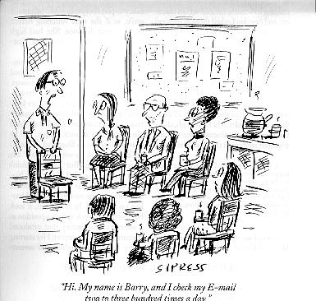
IPv6, Tunneling and Multicasting
Dr. Shelly Heller
sheller@gwu.edu

Slide 2
Chapter 4: Network Layer
Chapter goals:
understand principles behind network layer services:
  routing (path selection)
  dealing with scale
  how a router works
  advanced topics: IPv6, multicast
instantiation and implementation in the Internet
Chapter Overview:
network layer services
routing principle: path selection
  Link State
  Distance Vector
hierarchical routing
IP
Internet routing protocols reliable transfer
  intra-domain
  inter-domain
what’s inside a router?
IPv6
multicast routing
✓
✓
✓
✓
✓
✓
✓
✓
✓

Slide 3
What’s Inside a Router?
Input Port(s)
Output Port(s)
.
.
.
Switching Fabric
.
.
.
Routing
Processor
Switching Function – the actual transfer of datagrams from a router’s incoming links to the appropriate outgoing links

Slide 4
Input port processing
Switching Fabric
Line Termination
Lookup, Forwarding, Queuing
Data Link Processing
Line Termination: physical layer functionality
Data Link Processing: protocol decapsulation
Lookup, Forwarding, Queuing: shadow copy of routing table stored at each input port (updated as needed)

Slide 5
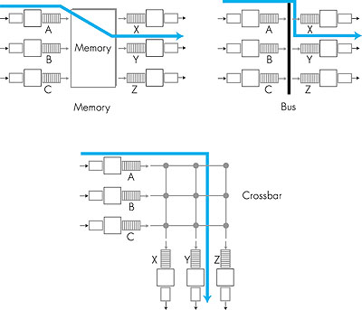
Switching Fabrics
Switching via Memory
  Simplest
  Under direct control of CPU
Switching via Bus
  Uses shared bus
  Routing processor not used
  Potential blocking
Switching via Interconnection:
  Higher BW possible (no blocking)
  Typically more expensive

Slide 6
Constant Addressable Memory
Hardware search engines – comparison circuitry, massively parallel
Router Address Lookup
  Ordered table search (Ologn)
  CAM (O(1))
Line Number | Address | Port
1 | 101XX | A
2 | 0110X | B
3 | 011XX | C
4 | 10011 | D
“X” is I don’t care – so each represents a range of addresses,
Packet address 01101, the address lookup matches both Line 2
and Line 3 in the table. Choose line2, it has more defined bits
Notes:
Conventional semiconductor memory (usually SRAM) with added comparison circuitry that enable a search operation to complete in a single clock cycle.

Slide 7
Output port processing
Switching Fabric
Queuing
Line Termination
Data Link Processing
Queuing : buffer management; potential for lost packets
Data Link Processing: protocol encapsulation
Line Termination: physical layer functionality

Slide 8
IPv6
AKA Next Generation IP (IPng)
32-bit IPv4 address space being exhausted
Opportunity to improve “tweak” existing protocol based upon years of operational experience
  Expanded addressing capabilities
  Streamlined 40-byte header
  Flow labeling and priority
New version of the ICMP protocol
  “Packet Too Big”
  “Unrecognized IPv6 options”
  Assumes some functionality of IGMP

Slide 9
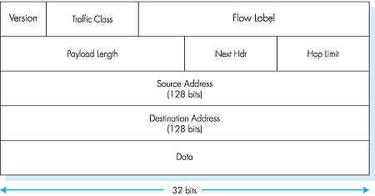
IPv6 Packet Format

Slide 10
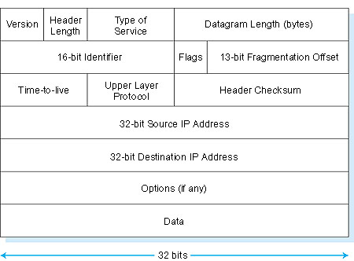
IPv4 Packet Format

Slide 11
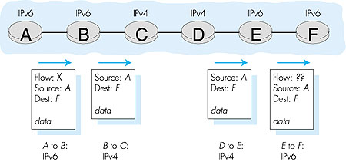
Transitioning from IPv4 to IPv6
Declare a “flag day” – not feasible
Dual-stack approach (RFC 1933)

Slide 12
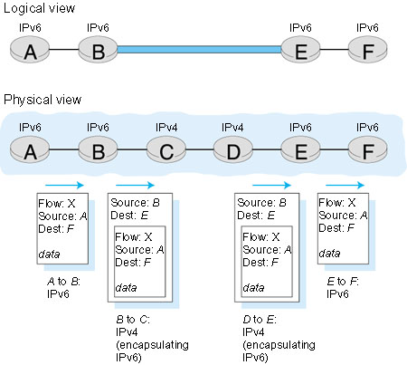
Transitioning from IPv4 to IPv6 (cont)
Tunneling

Slide 13
Multicast history
In 1995 the first mcast network was born: MBone
DVMRP (Distance Vector Multicast Routing Protocol) was the protocol used
  DVMRP subnetworks was interconnected through the unicast Internet infrastructure with tunnels
  Flood and Prune technology
  Very successful in academic circles
BUT>>>>>

Slide 14
Didn’t scale
DVMRP can’t scale to Internet sizes
  Distance vector-based routing protocol
  Periodic updates
    Full table refresh every 60 seconds
  Table sizes
    Internet > 40,000 prefixes at that moment
  Scalability
    Too many tunnels, hop-count till 32 hops, etc
In 1997, a native protocol is developed, Protocol Independent Multicast (PIM)

Slide 15
Multicast Routing
Unicast – one sender and one receiver
Multicast – one or more senders to a group of receivers – implicitly (receivers pass it on) or explicitly (group)
  Bulk data transfer, e.g. ghosting
  Streaming continuous media
  Shared data applications
  Data feeds, e.g. stock quotes
  WWW cache updating
  Interactive gaming
Connection-oriented
  State information established and maintained

Slide 16
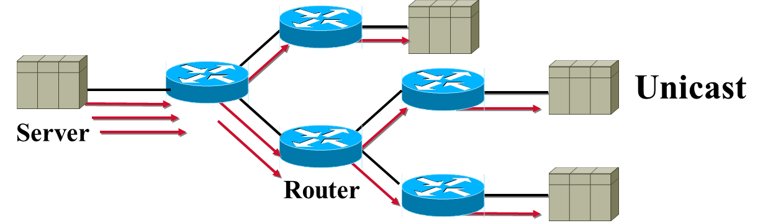
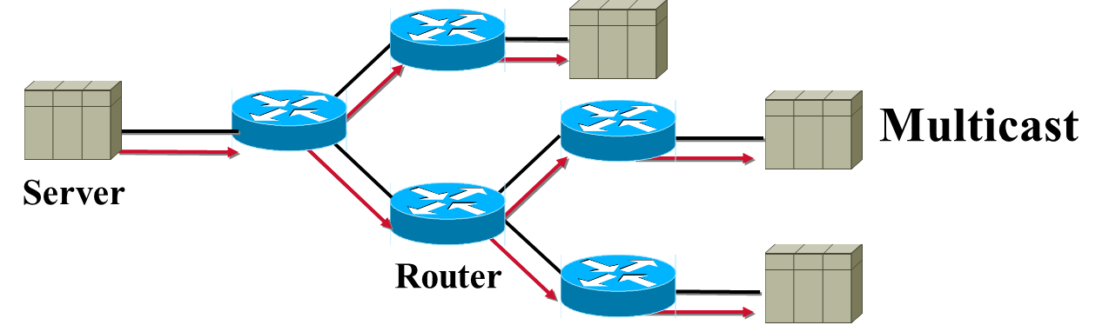
Multicast vs Unicast

Slide 17
Multicast Routing vs Unicast Routing
Multicast Routing is backwards from Unicast Routing
  Unicast Routing is concerned about where the packet is going.
  Multicast Routing is concerned about where the packet came from.
Multicast Routing uses "Reverse Path Forwarding“ (coming in a few slides)

Slide 18
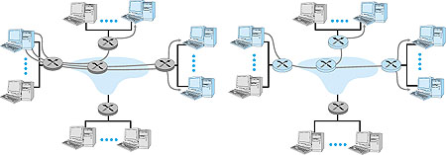
Internet Multicast Abstraction
Option 1 –
Sender uses separate transport connection to each receiver
Option 2 –
Sender transmits a single datagram

Slide 19
Building Blocks for Multicasting
The SENDERS send
  Multicast Addressing - rfc1700
  class D (224.0.0.0 - 239.255.255.255)‏ Reserved addresses
The RECEIVERS inform the routers what they want to receive
  Internet Group Management Protocol (IGMP) - rfc2236 -> version 2
The routers make sure the STREAMS make it to the correct receiving nets.
  Multicast Routing Protocols (PIM-SM/SSM)‏
  RPF (reverse path forwarding) – against source address

Slide 20
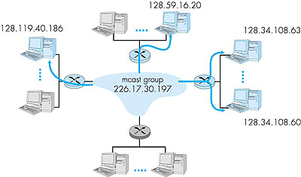
The Multicast group
  Multicast datagram addressed using address indirection – “group name”
  Class D multicast address (aka multicast group) is a single identifier that represents a group of receivers
  Each host has a unique multicast address independent of the multicast group address

Slide 21
Protocol Independent Mutlicast
It is termed protocol-independent because PIM does not include its own topology discovery mechanism
uses routing information supplied by other routing protocols.
PIM is not dependent on a specific unicast routing protocol; use of any unicast routing protocol.
PIM does not build its own routing tables. PIM uses the unicast routing table for reverse path forwarding.^{[1]:56-57}

Slide 22
PIM - Dense
PIM Dense mode
  Flood and Prune behavior very inefficient
    Can cause problems in certain network topologies
  Creates (S, G) state in EVERY router
    Even when there are no receivers for the traffic
  Complex Assert mechanism
    To determine which router in a LAN will forward the traffic
  No support for shared trees

Slide 23
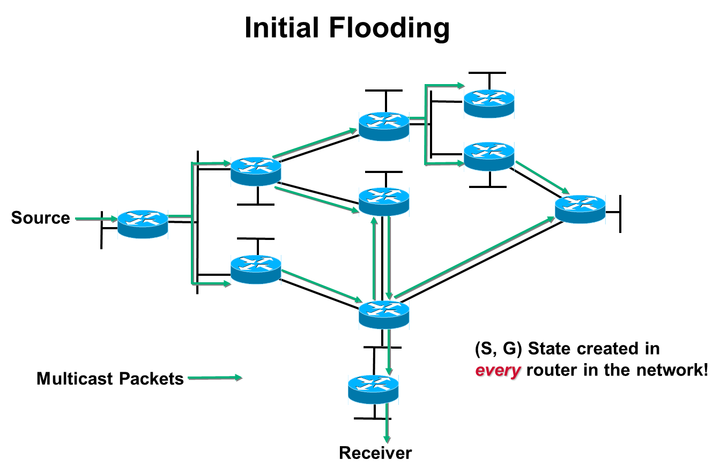

Slide 24
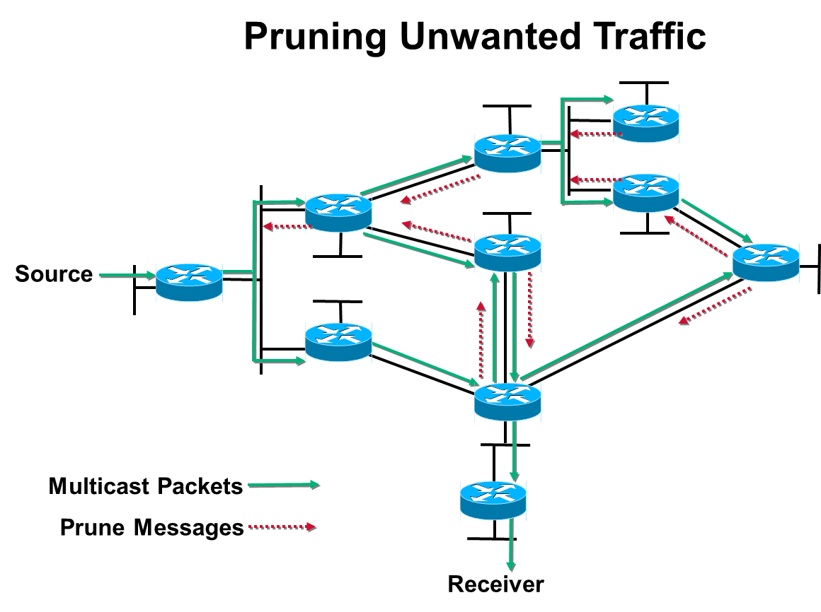

Slide 25
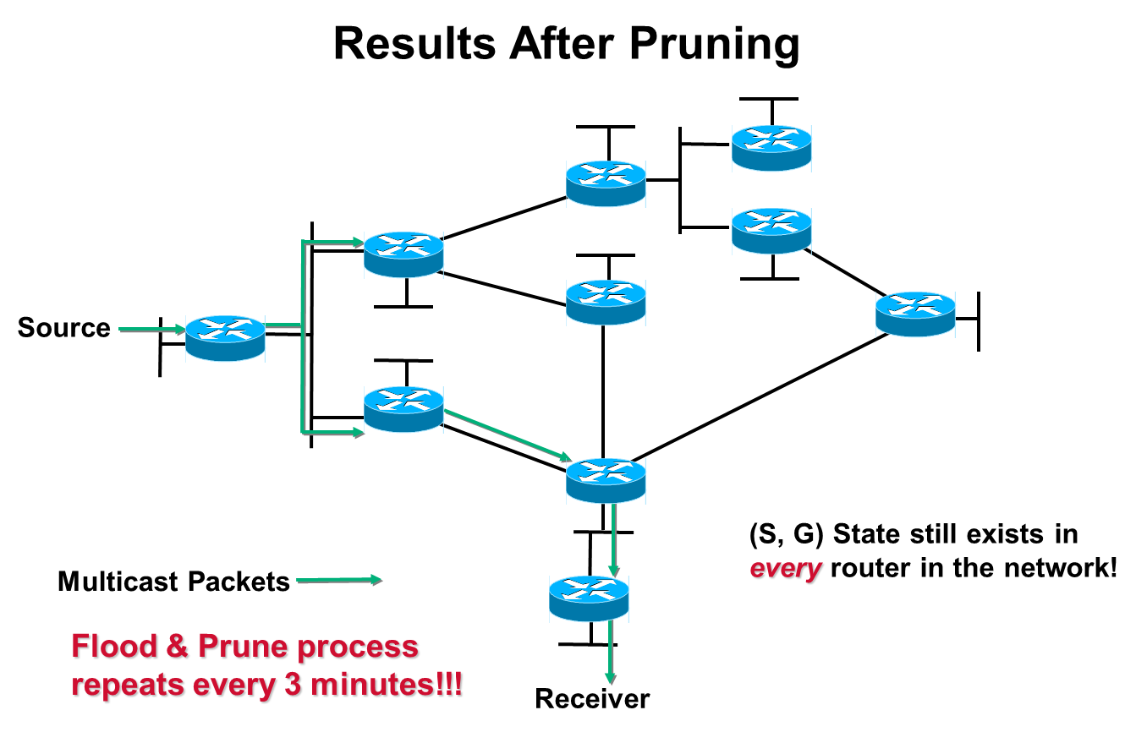

Slide 26
PIM Sparse
PIM Sparse mode
  Must configure a Rendezvous Point (RP)‏
    Statically (on every Router)‏
    Using Auto-RP or BSR (Routers learn RP automatically)‏
  Very efficient
    Uses Explicit Join model
    Traffic only flows to where it’s needed
    Router state only created along flow paths
  Scales better than dense mode
    Works for both sparsely or densely populated networks

Slide 27
Reverse Path Forwarding
What is RPF?
  A router forwards a multicast datagram only if received on the up stream interface to the source (i.e. it follows the distribution tree).
The RPF Check
  The source IP address of incoming multicast packets are checked against a unicast routing table.
  If the datagram arrived on the interface specified in the
  routing table for the source address; then the RPF check
  succeeds.
  Otherwise, the RPF Check fails.

Slide 28
IGMP Protocol
  Internet Group Management Protocol (RFC 2236) operates between a host and its directly attached router
  Mechanism for host to inform router that an application wants to join a specific multicast group
  Scope limited to host and attached router
  Coordination of multicast routers is accomplished by the network-layer multicast routing algorithms such as PIM, DVMRP, and MOSFP. IGMP is ONLY between host and attached router. These protocols help route multicast datagrams to destinations.
  PIM – protocol independent multicast
  DVMRP – distance vecter multicast routing protocol
  MOSFP – Multicast Open Shortest Path

Slide 29
IGMP v2 Message Types
IGMP Message Types Sent by Purpose
Membership query: general router Query multicast groups
joined by attached routers
Membership query: specific router Query if specific multicast
group joined by attached hosts
Membership report host Report host wants to join or is
joined to a given multicast group
Leave group host Report leaving given multicast
group – optional (can learn this
from no response to ‘report’)

Slide 30
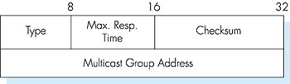
IGMP Message Format
  Messages are encapsulated within an IP datagram
  Max Response Time – feedback suppression
  Uses IP protocol number 2

Slide 31
Multicast Forwarding States
Forwarding state:
  Source address
  Group address
  Incoming interface
  Outgoing interface list
  Various times – for aging entries
  Flags ( for PIM)

Slide 32
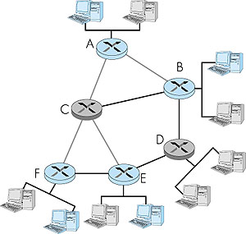
Multicast Routing Problem
  Only routers A, B, E, and F need to receive the multicast traffic
  Find a tree of links to connect the group – might go via C and
  Or D – A single tree to all (Group) OR Each sender has its own
  Tree (Source)

Slide 33
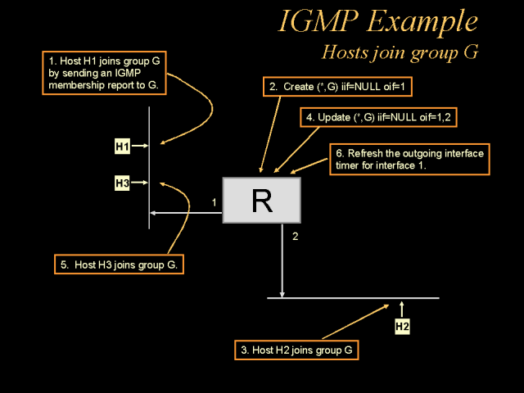
Host joins
OIF – Outgoing Interface List

Slide 34
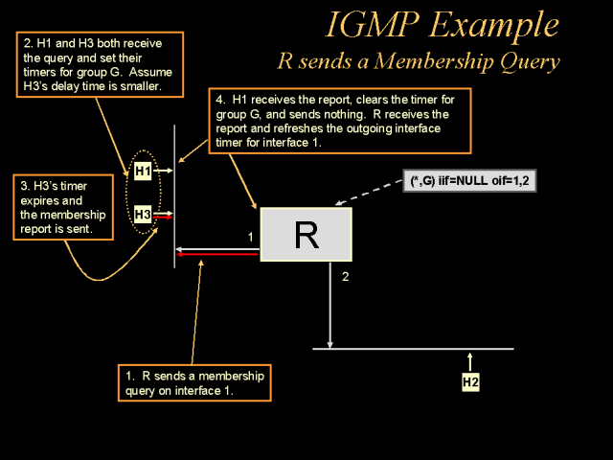
Membership query

Slide 35
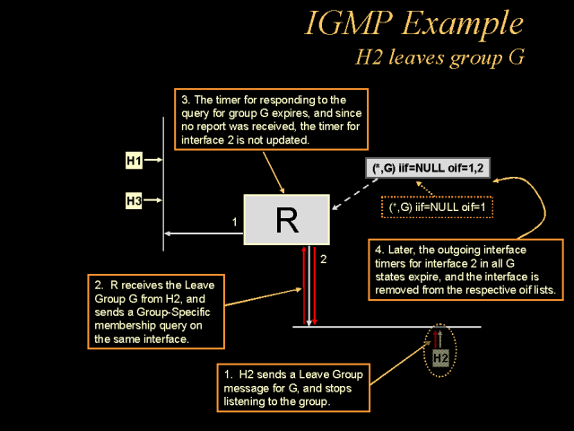
Host leaves

Slide 36
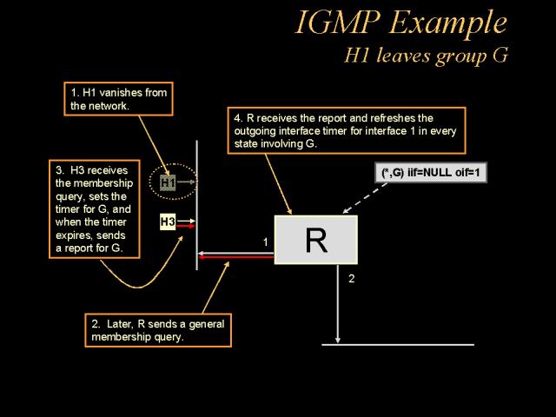
Next Host leaves
Notes:
OIF (Outgoing Interface List)
http://www.slac.stanford.edu/grp/scs/net/talk/multicast-slac/sld016.htm

Slide 37
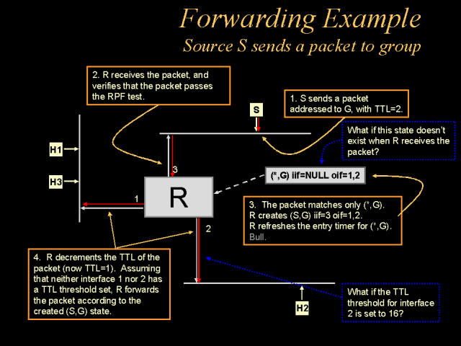
Forwarding
RPF – reverse path forwarding
Notes:
The golden rule: Reverse Path Forwarding (RPF)
A router accepts a multicast packet from a source if and only if the packet has been received over the interface used to send unicast packets to the source
If the RPF test succeeds, the packet is forwarded to all the interfaces included in the router’s OIF (Outgoing Interface List)
If the RPF test fails, the multicast packet is discarded
A packet should never be re-sent over the RPF interface (to avoid loops)

Slide 38
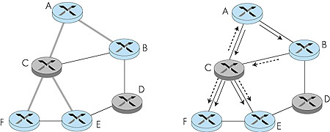
Determining the multicast routing tree
Group-shared tree – single routing tree is constructed for entire multicast group
Source-based tree – individual routing tree is constructed for each sender

Slide 39
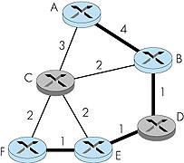
Minimum-cost Group Shared multicast tree

Slide 40
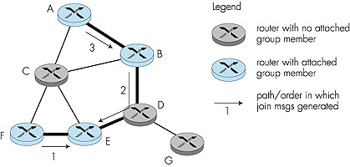
Constructing a center-based tree group shared
Find a central node (E)
Routers “unicast” join messages to center or a router belonging to group
Path defines the “branch”

Slide 41
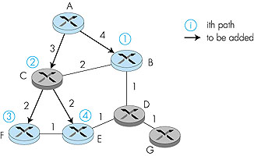
Constructing a least-cost path routing tree
Uses Reverse Path Forwarding

Slide 42
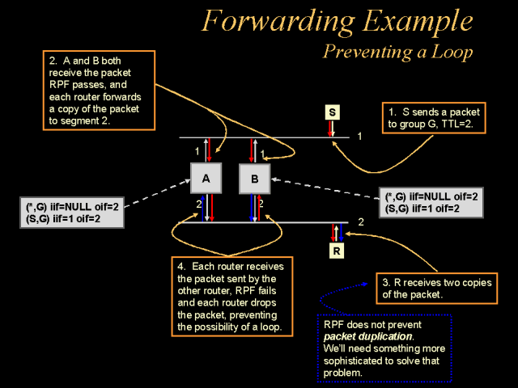
Reverse path forward check

Slide 43
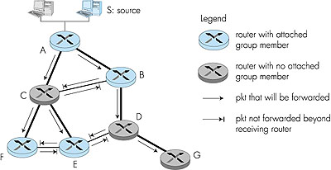
Reverse path forwarding

Slide 44
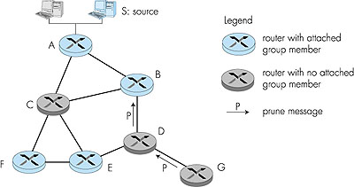
Pruning an RPF tree
Routers that receive multicast messages
but have no hosts in that group send a prune message.
Then the upstream router will no longer send messages.

Slide 45
Multicast Routing in the Internet
Distance Vector Multicast Routing Protocol (DVMRP)
  De facto standard
  Uses source-based trees w/ reverse path forwarding, pruning, and grafting
  Distance vector algorithm
Multicast Open Shortest Path First (MOSPF)
  Operates in an AS that uses OSPF
  All routers must have complete topology information
Core-Based Trees (CBT)
  Builds a bi-directional group-shared tree with a single center
Protocol Independent Multicast (PIM)
  Two distribution scenarios, dense mode & sparse mode

Slide 46
Inter-Autonomous System Multicast Routing
Factors involved in evaluating a multicast protocol
  Scalability
  Reliance on underlying unicast routing
  Excess (un-needed) traffic received
  Traffic concentration
  Optimality of forwarding paths

